Slide 1

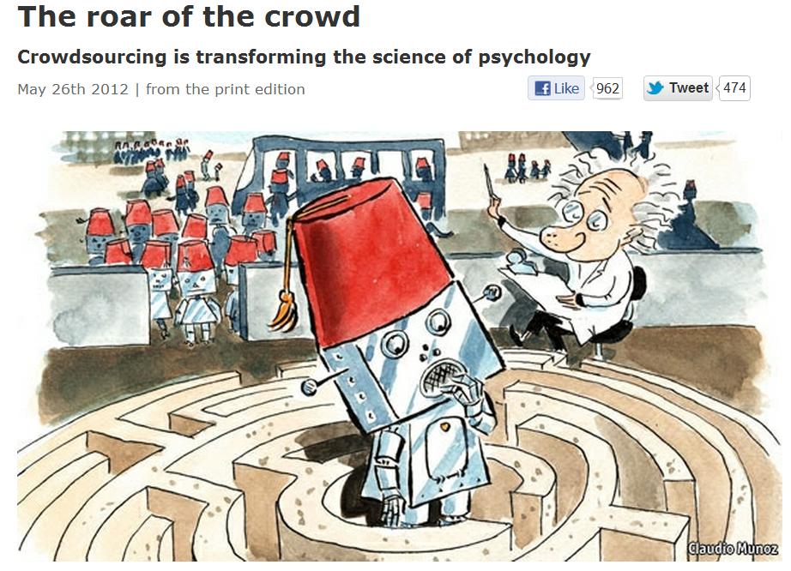

Slide 2

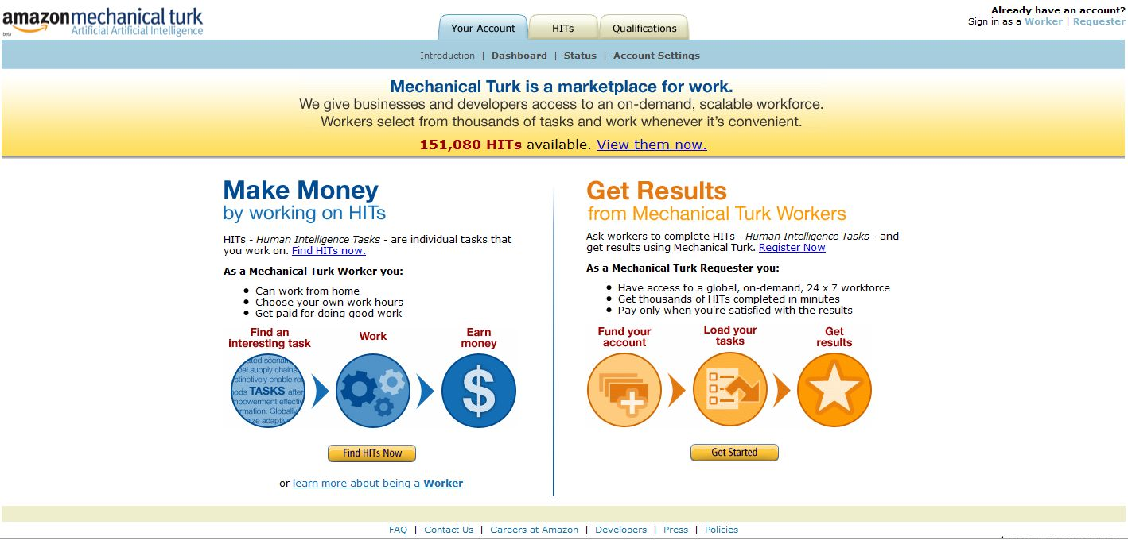
Notes:
MTurk is an online marketplace

Slide 3
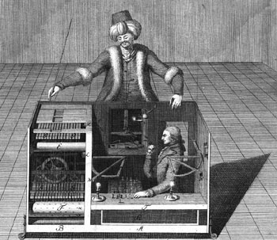
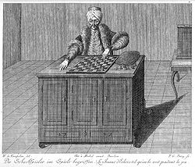
Notes:
The Turk, the Mechanical Turk or Automaton Chess Player was a fake chess-playing machine constructed in the late 18th century. From 1770 until its destruction by fire in 1854, it was exhibited by various owners as an automaton, though it was explained in the early 1820s as an elaborate hoax.^{[1]} Constructed and unveiled in 1770 by Wolfgang von Kempelen (1734–1804) to impress the Empress Maria Theresa, the mechanism appeared to be able to play a strong game of chess against a human opponent, as well as perform the knight's tour, a puzzle that requires the player to move a knight to occupy every square of a chessboard exactly once.
The Turk was in fact a mechanical illusion that allowed a human chess master hiding inside to operate the machine. With a skilled operator, the Turk won most of the games played during its demonstrations around Europe and the Americas for nearly 84 years, playing and defeating many challengers including statesmen such as Napoleon Bonaparte and Benjamin Franklin. Although many had suspected the hidden human operator, the hoax was initially revealed only in the 1820s by the Londoner Robert Willis.^{[2]}

Slide 4
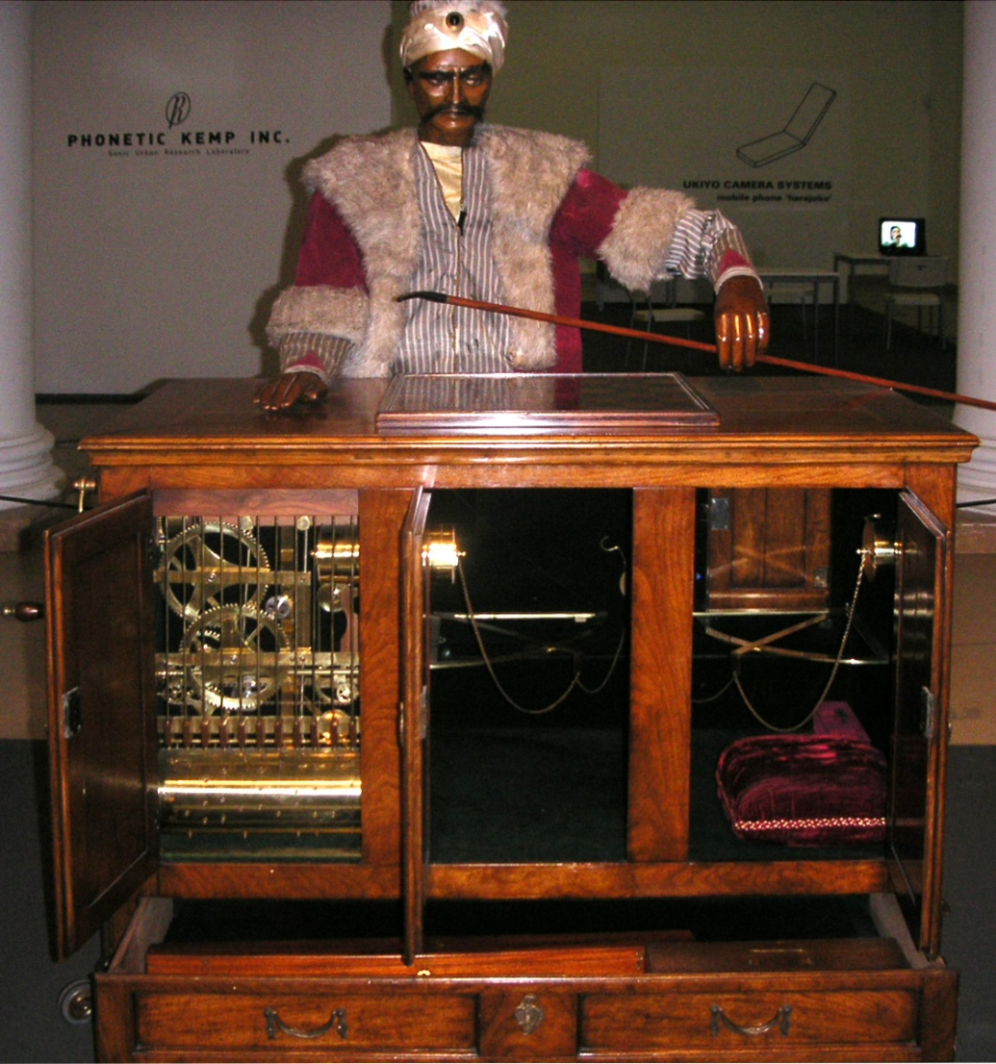
Notes:
The Turk, the Mechanical Turk or Automaton Chess Player was a fake chess-playing machine constructed in the late 18th century. From 1770 until its destruction by fire in 1854, it was exhibited by various owners as an automaton, though it was explained in the early 1820s as an elaborate hoax.^{[1]} Constructed and unveiled in 1770 by Wolfgang von Kempelen (1734–1804) to impress the Empress Maria Theresa, the mechanism appeared to be able to play a strong game of chess against a human opponent, as well as perform the knight's tour, a puzzle that requires the player to move a knight to occupy every square of a chessboard exactly once.
The Turk was in fact a mechanical illusion that allowed a human chess master hiding inside to operate the machine. With a skilled operator, the Turk won most of the games played during its demonstrations around Europe and the Americas for nearly 84 years, playing and defeating many challengers including statesmen such as Napoleon Bonaparte and Benjamin Franklin. Although many had suspected the hidden human operator, the hoax was initially revealed only in the 1820s by the Londoner Robert Willis.^{[2]}

Slide 5
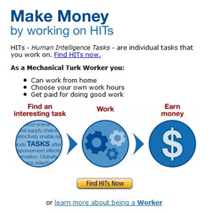
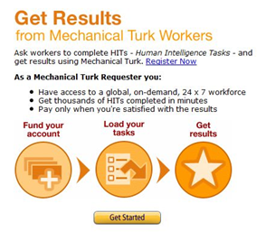
Notes:
Check to make sure it works in Europe….

Slide 6
(My) reasons for using crowdsourcing
Easy (and cheap) data
Diverse
Intuition pump

Slide 7
(My) reasons for using crowdsourcing
Easy (and cheap) data
Diverse
Intuition pump

Slide 8
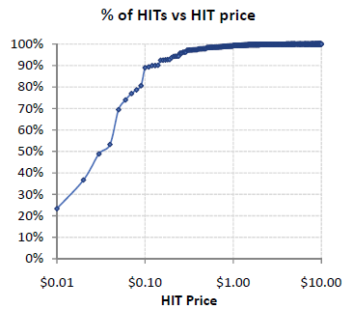
Easy (and cheap) data
Median hit - $0.06
Iperotis, 2010b

Slide 9
(My) reasons for using crowdsourcing
Easy (and cheap) data
Diverse
Intuition pump

Slide 10
>500,000 “Workers”
~35-40% US; 30-50% India
+ ~100 countries
Notes:
Amazon does not release demographics

Slide 11
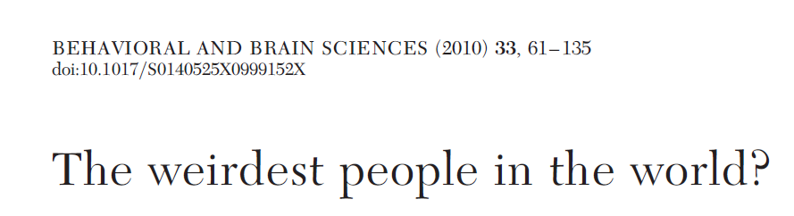
Heinrich, Heine, Norenzayan, 2010
Western
Educated
Rich
Industrialized
Democracies
“a randomly selected American undergraduate is more than 4,000 times more likely to be a research participant than is a randomly selected person from outside of the West” (p. 63)
Notes:
So if your concern is that too many of your subjects are <click>WEIRD
and that this is a problem.

Slide 12
(My) reasons for using crowdsourcing
Easy (and cheap) data
Diverse
Intuition pump

Slide 13
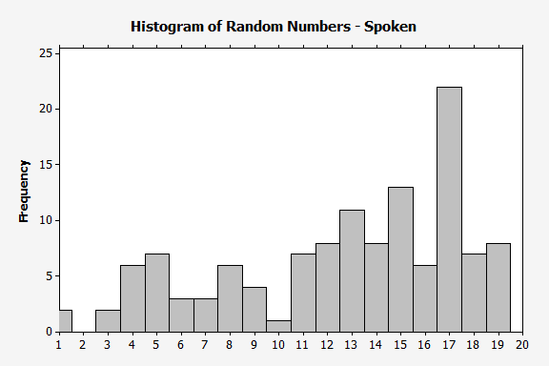
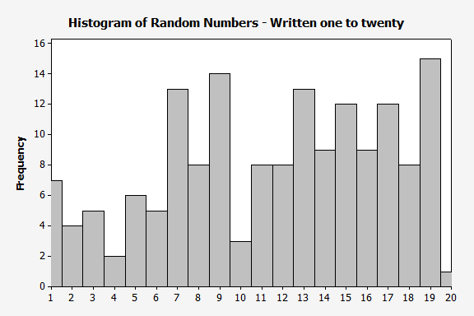
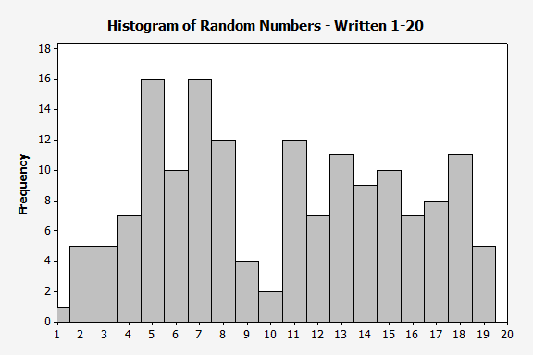
N=126
(135 tested)
$2.70 + 10%

Slide 14
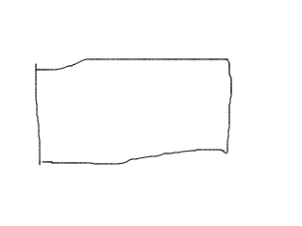

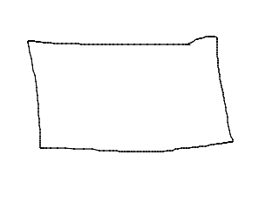


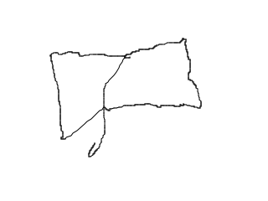
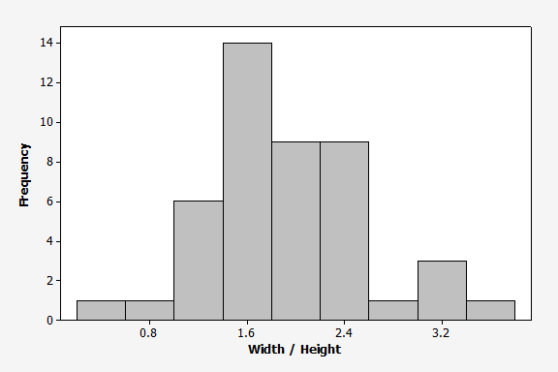
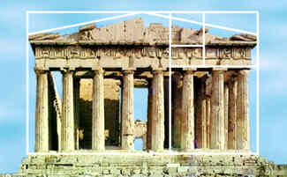

Slide 15
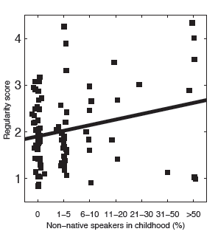
How acceptable is it to say:
He speeded down the road
He lighted the candles
They sneaked around
etc.
r = :23, p = :025
Logit reg. odds 􀀀 ratio = :78, p = :028
Dale & Lupyan, 2011

Slide 16
Who_{works}
Self reported demographic information from 2,896 workers over 3 years (MW ‘09, MW ‘11, SW ’10)
55% Female, 45% Male
  Similar to other internet panels (e.g. Goldstein)
Age:
  Mean: 30 yrs,
  Median: 32 yrs
Mean Income: $30,000 / yr
Slide adapted from Winter Mason’s presentation: http://www.slideshare.net/winteram

Slide 17
Why
“MTurk money is always necessary to make ends meet.”
  5% U.S. 13% India
“MTurk money is irrelevant.”
  12% U.S. 10% India
“MTurk is a fruitful way to spend free time and get some cash.”
  69% U.S. 59% India
Ross et al ’10, Ipeirotis ’10
Slide adapted from Winter Mason’s presentation: http://www.slideshare.net/winteram

Slide 18
Common Tasks
What
Image labeling
Audio transcription
Classification: images, websites
Product evaluation
Uncommon Tasks
Workflow optimization
Copy editing
Product description
Technical writing
Slide adapted from Winter Mason’s presentation: http://www.slideshare.net/winteram
Notes:
Is this a porn site..?

Slide 19
Who_{requests}
Companies crowdsourcing part of their business
  Search companies: relevance
  Online stores: similar products from different stores (identifying competition)
  Online directories: accuracy, freshness of listings
  Researchers
Intermediaries
  CrowdFlower
  Smartsheet.com
CrowdFlower is the leader in enterprise crowdsourcing. CrowdFlower’s technology platform offers quality-ensured crowdsourcing at massive scale. The company solves problems ranging from product categorization to business lead verification to content creation. Clients from startups to the Fortune 500 enjoy increased flexibility, faster turnaround time and cost savings.
…..CrowdFlower takes large, data-heavy projects and breaks them into small tasks that are distributed to more than 1.5 million on-demand contributors globally.
Slide adapted from Winter Mason’s presentation: http://www.slideshare.net/winteram

Slide 20
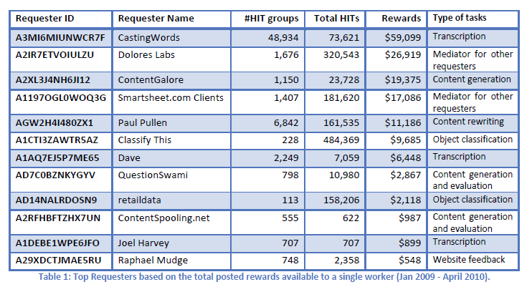
Who_{requests}
What
Iperotis, 2010b

Slide 21
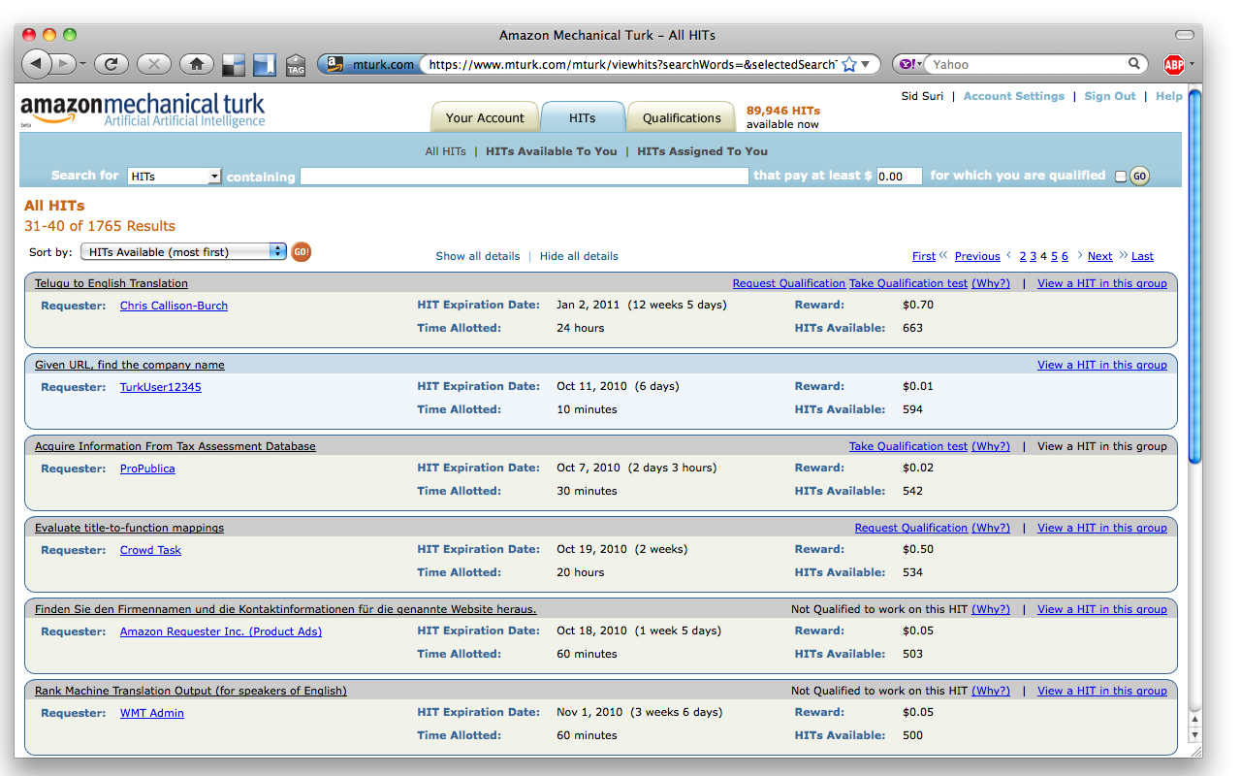
Anatomy
of a HIT

Slide 22
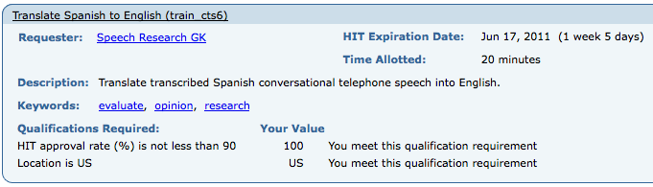
Anatomy
of a HIT
HITs with the same title, description, pay rate, etc. are the same HIT type
(for us, it’s mostly 1 HIT / Hit Type)
HITs are broken up into Assignments
  A worker cannot do more than 1 assignment of a HIT
Not everyone is eligible to do every HIT
Slide adapted from Winter Mason’s presentation: http://www.slideshare.net/winteram

Slide 23
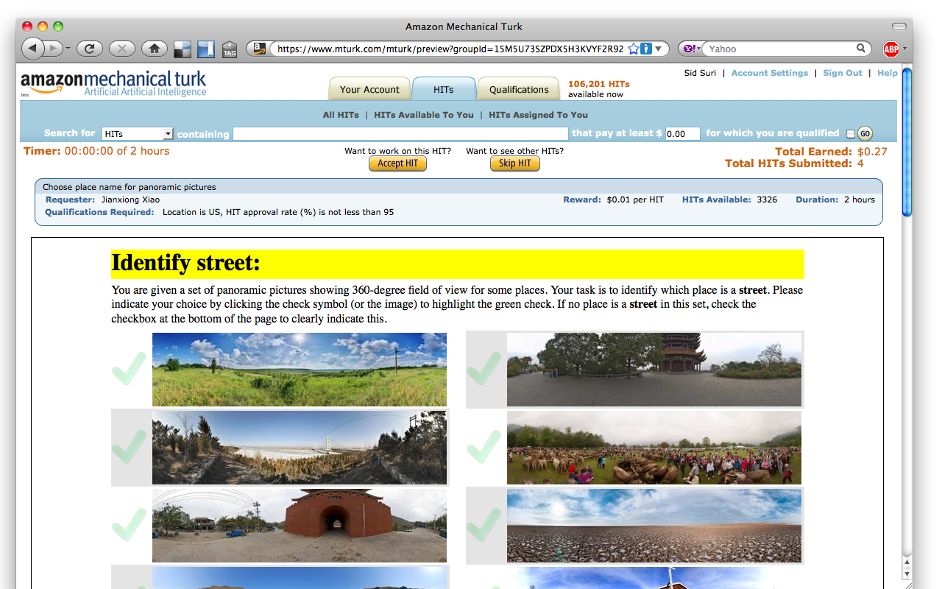
Some HIT groups have many HITs
Slide adapted from Winter Mason’s presentation: http://www.slideshare.net/winteram
Notes:
Internal HITs are hosted by Amazon
External HITs are hosted by the requester
HITs can be tested on {requester, worker}sandbox.mturk.com

Slide 24
HIT GROUP
Assignment 1
“Black”
Alice
Assignment 2
“Night”
Which is the better translation for Táy ?
    Black
    Night
HIT 1
Bob
Which is the better translation for Nedj ?
    Clean
    White
HIT 2
•
Assignment 3
“Black”
•
•
Charlie
Slide adapted from Winter Mason’s presentation: http://www.slideshare.net/winteram

Slide 25
HIT GROUP
Assignment 1
“White”
Which is the better translation for Táy ?
    Black
    Night
HIT 1
Alice
Assignment 2
“White”
Which is the better translation for Nedj ?
    Clean
    White
HIT 2
•
Bob
•
•
Assignment 3
“White”
David
Slide adapted from Winter Mason’s presentation: http://www.slideshare.net/winteram

Slide 26
Requester
Worker
Build HIT
Test HIT
Search for HITs
Post HIT
Accept HIT
Do work
Reject or Approve HIT
Submit HIT
Slide adapted from Winter Mason’s presentation: http://www.slideshare.net/winteram

Slide 27
miscellany
Requester is only limited by $ in account.
You cannot ask for work without having the $ to pay for it.
Amazon charges requesters 10% or $.005 / assignment
A HIT completes when it expires or all assignments are completed

Slide 28
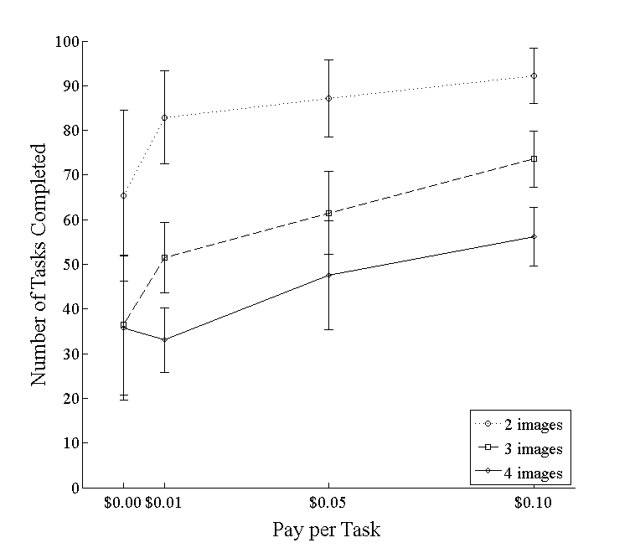
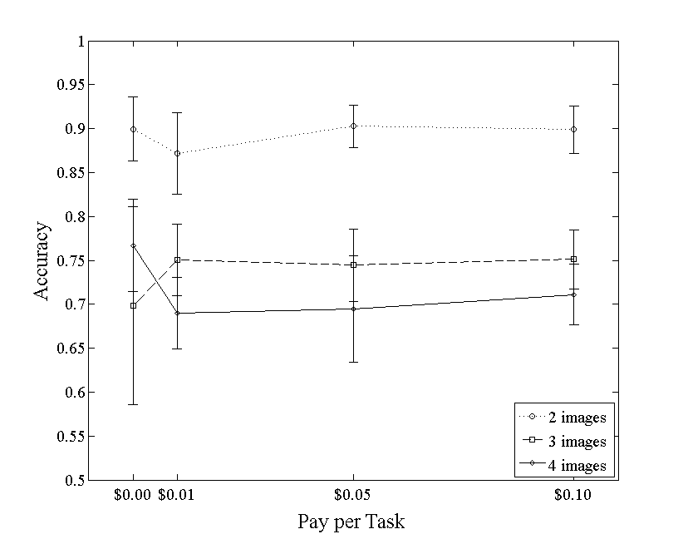
How much $?
Pay rate can affect quantity of work
Pay rate does not have a big impact on quality
Number of Tasks Completed
Accuracy
Pay per Task
Pay per Task
Slide adapted from Winter Mason’s presentation: http://www.slideshare.net/winteram

Slide 29
Completion Time
3, 6-question multiple choice surveys
Launched same time of day, day of week
$0.01, $0.03, $0.05
Past a threshold, pay rate does not increase speed
Start with low pay rate work up
Slide adapted from Winter Mason’s presentation: http://www.slideshare.net/winteram

Slide 30
Turker Community
Reputation of Workers is given by approval rating
  Requesters can reject work
  Requesters can refuse workers with low approval rates
  Workers can also rate requesters (stay tuned)

Slide 31
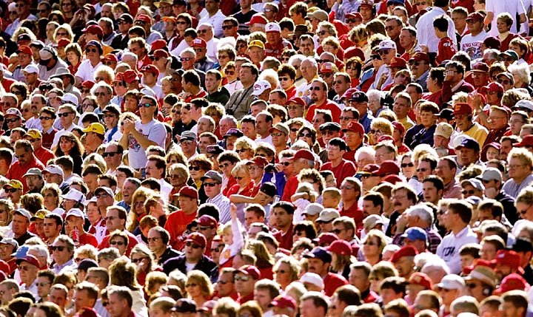
Notes:
Crowd power

Slide 32
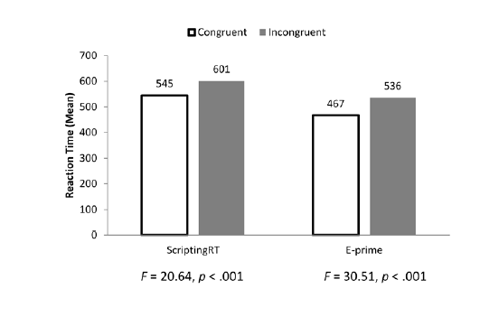
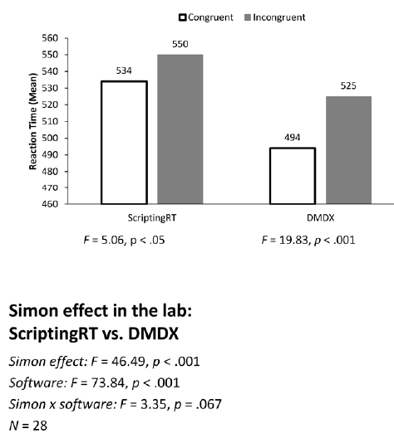
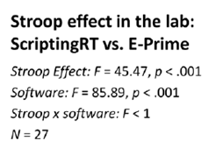
Validity

Slide 33
<p>Please enter the code you were provided when you completed answering the questions below:</p>
<script type='text/javascript'>
function getParamFromURL( name )
{
name = name.replace(/[\[]/,"\\[").replace(/[\]]/,"\\]");
var regexS = "[\?&]"+name+"=([^&#]*)";
var regex = new RegExp( regexS );
var results = regex.exec( window.location.href );
if( results == null )
return "";
else
return results[1];
}
//GET PARAMETERS
var usernameFromParamString = getParamFromURL( 'workerId' );
var assignmentIdFromParamString = getParamFromURL( 'assignmentId' );
var hitIdFromParamString = getParamFromURL( 'hitId' );
//CREATE AND POST LINK TO REAL HIT
var link = "https://uwmadison.qualtrics.com/SE/?SID=SV_b78uzqEFp9eiGKU&worker=" + usernameFromParamString + "&assignment=" + assignmentIdFromParamString + "&hit=" + hitIdFromParamString;
document.write("<iframe src=" +link + " width=\"800\" height=\"600\"><br></iframe>");
</script>
<p>Completion code:&nbsp;<input type="text" name="Q2" id="Q2" size="20" /></p>

Slide 34
How

Slide 35
Qualtrics and Mturk
-As good as point and click gets

Slide 36
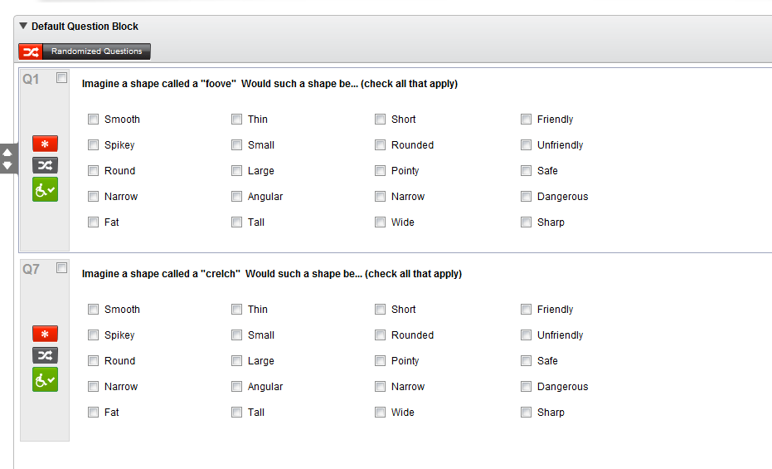

Slide 37
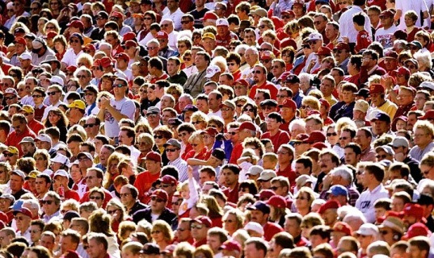
Imagine a shape called a "foove“ (“crelch”) Would such a shape be...
Notes:
In addition to

Slide 38
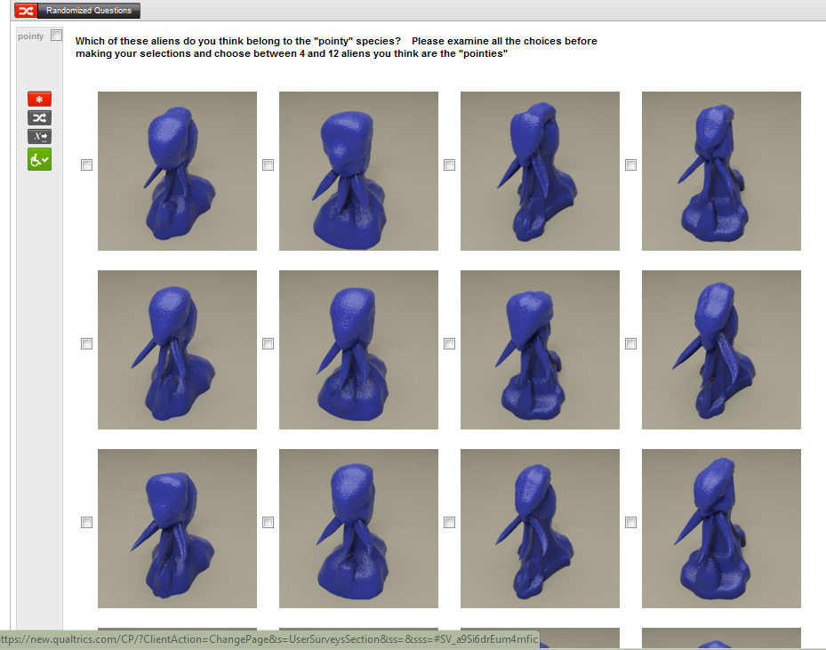

Slide 39
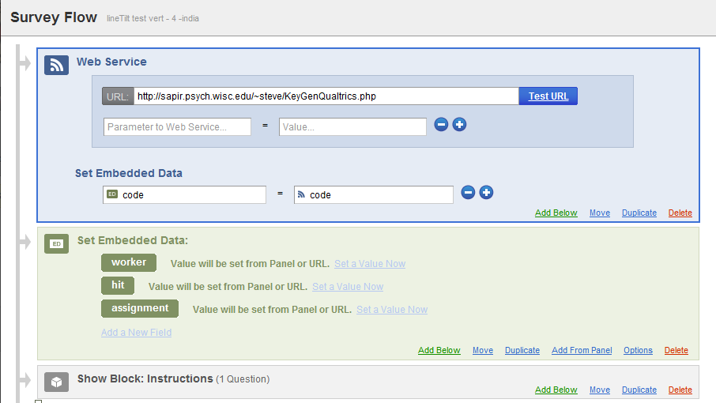

Slide 40
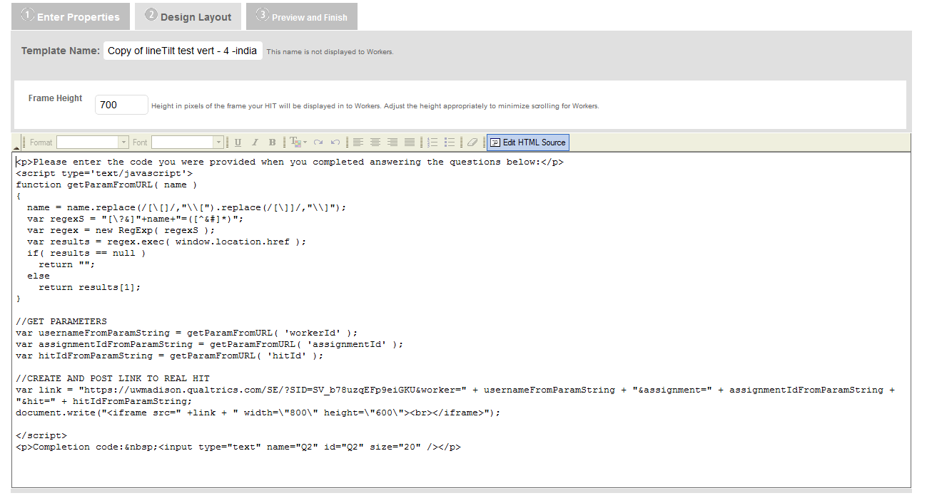

Slide 41
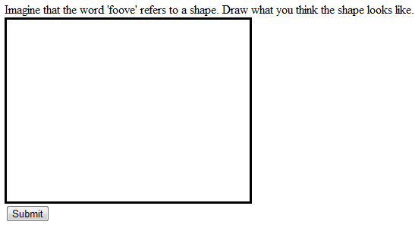

Slide 42
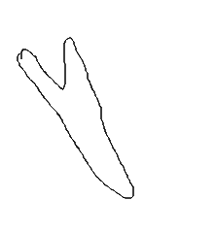
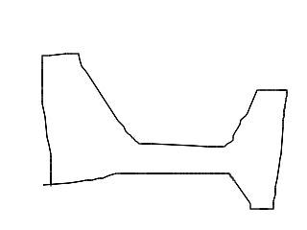
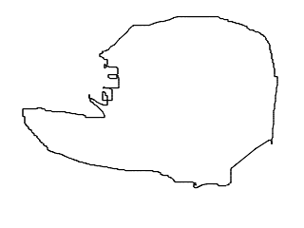

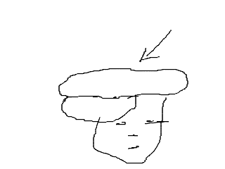
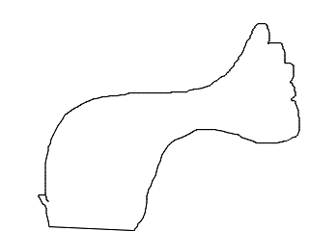
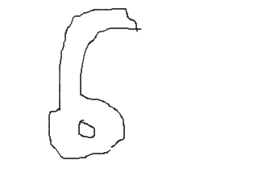
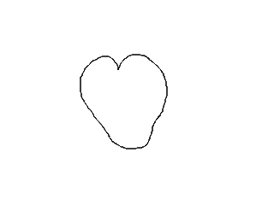
Imagine that the word ‘crelch’ refers to a shape.
Draw what you think the shape looks like
Imagine that the word ‘foove’ refers to a shape.
Draw what you think the shape looks like
Notes:
And in fact, these shapes were drawn by participants in *response* to a prompt to draw these so-called nonsense shapes.

Slide 43
If you can code it, you can run it.
Notes:
If you can code it, you can run it.
scriptingRT people testing timing
https://plus.google.com/photos/113985244454991130849/albums/5730153583934109873/5730153610168783810?authkey=CL7I__yygrfgogE

Slide 44
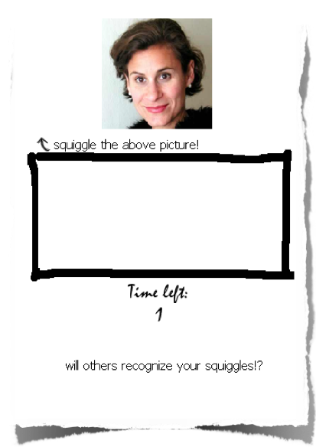

Slide 45
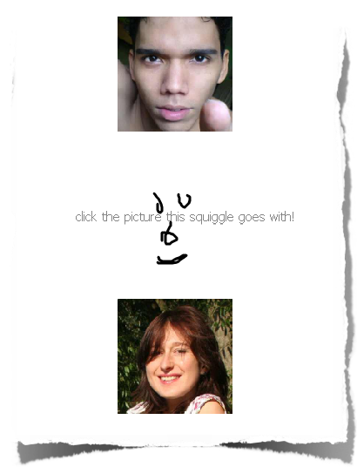


Slide 46
Test run #1
Recruited through social network contacts.
Overall, about ~60 players, produced 1,377 squiggles, and “listened” 4,136 times.
Collected in 1 day.
One user played for 1 hour straight.

Slide 47
Test Run 2
53 participants from Amazon’s crowdsourcing service Mechanical Turk
1,034 squiggles, > 3,000 listens
Collected in under 1 day
Some users played for over 30 minutes.
Effective hourly rate:
  $0.15 / hour

Slide 48
Tips
Be creative. Don’t try to force a lab study into a Turk format.
Notes:
Sometimes it can feel like you are sending work to a robot. They are real people.
Reputation – both yours and the workers – is key.
If you are not paying enough and they are filtering by >[$], they won’t see your HIT

Slide 49
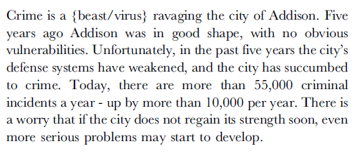
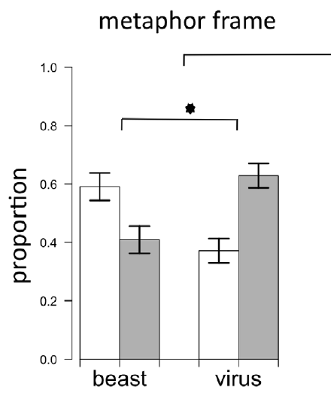
Thibodeau & Boroditsky, 2011
Notes:
Left: Exp 2
1) In your opinion what does Addison need to do to reduce crime? 2) What is the role of a police officer in Addison? 3) Please copy the part of the report that was most influential and paste it in the text area below.
Right: Exp 3
The design of Experiment 3 was similar to
that of Experiment 2; however, before participants read the crime
report, they were shown the word ‘‘beast’’ or the word ‘‘virus’’ and
were asked to ‘‘list a synonym’’ for it. After completing this task,
they were presented with the paragraph on crime in Addison on a
separate screen. The crime report used in Experiment 3 was the
same as the crime report for Experiment 2, except that it did not
contain a virus or beast metaphor. The first sentence of the report
read: ‘‘Crime is ravaging the city of Addison.’’ It was otherwise
identical to the report from Experiment 2.

Slide 50
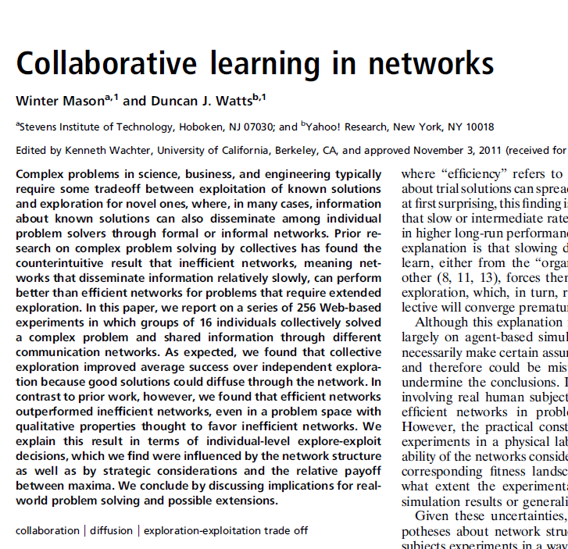
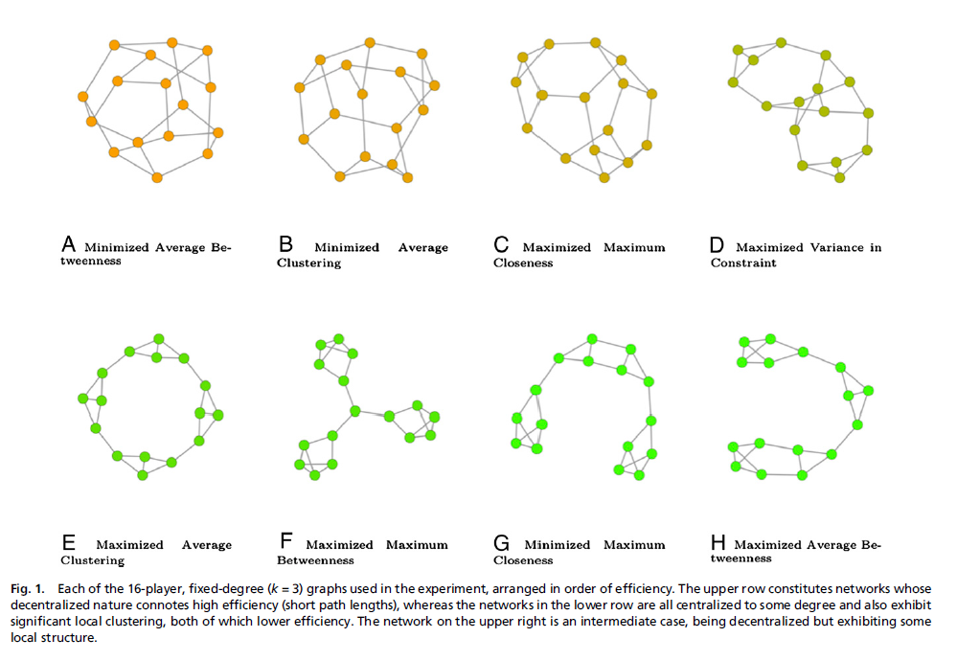

Slide 51
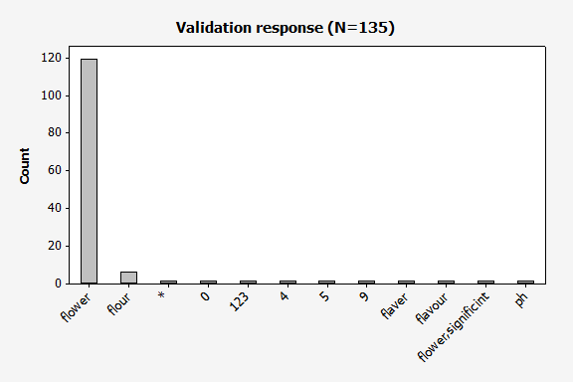
Tips
Validate the work when necessary.
Notes:
Sometimes it can feel like you are sending work to a robot. They are real people.
Reputation – both yours and the workers – is key.
If you are not paying enough and they are filtering by >[$], they won’t see your HIT

Slide 52
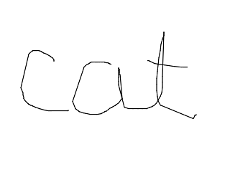
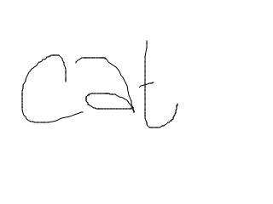





Slide 53
Tips
Take the workers perspective.
Are you describing your HIT well?
Are you paying people fairly?
Are you rejecting work fairly?
Posting a HIT at 3AM and expecting results?
Ask workers for feedback
Be aware of your reputation
Turkopticon, Turker Nation
Notes:
Sometimes it can feel like you are sending work to a robot. They are real people.
Reputation – both yours and the workers – is key.
If you are not paying enough and they are filtering by >[$], they won’t see your HIT
“

Slide 54


Slide 55

IRB

Slide 56
IRB
(f) Human subject means a living individual about whom
an investigator (whether professional or student) conducting
research obtains
(1) Data through intervention or interaction with the individual, or
(2) Identifiable private information.
Intervention includes both physical procedures by which data are gathered (for example, venipuncture) and manipulations of the subject or the subject's environment that are performed for research purposes.
Interaction includes communication or interpersonal contact between investigator and subject.
Private information includes information about behavior that occurs in a context in which an individual can reasonably expect that no observation or recording is taking place, and information which has been provided for specific purposes by an individual and which the individual can reasonably expect will not be made public (for example, a medical record). Private information must be individually identifiable (i.e., the identity of the subject is or may readily be ascertained by the investigator or associated with the information) in order for obtaining the information to constitute research involving human subjects.

